Slide 1

Fruitful Minds Week 6 Course Review Activity

Slide 2
Food Groups
Food Labels
Physical Activities
Real life Scenarios
Nutrients
100
100
100
100
100
200
200
200
200
200
300
300
300
300
300
400
400
400
400
400

Slide 3
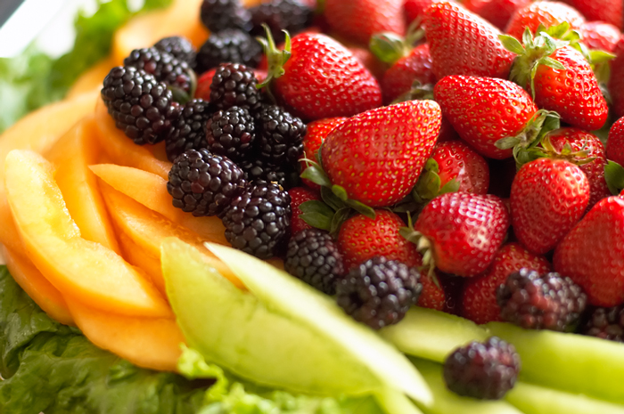
[Food Group 100]
How many servings of fruits should we eat each day?

Slide 4
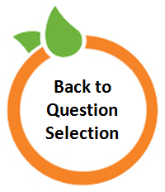
[Food Group 100]
Ans: 2-3 servings

Slide 5
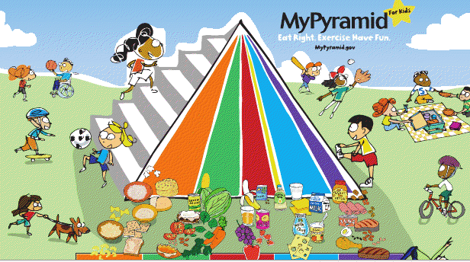
[Food Group 200]
We can categorize food into six groups. Three of them are grains, oils, and fruits. What are the other three food groups?

Slide 6
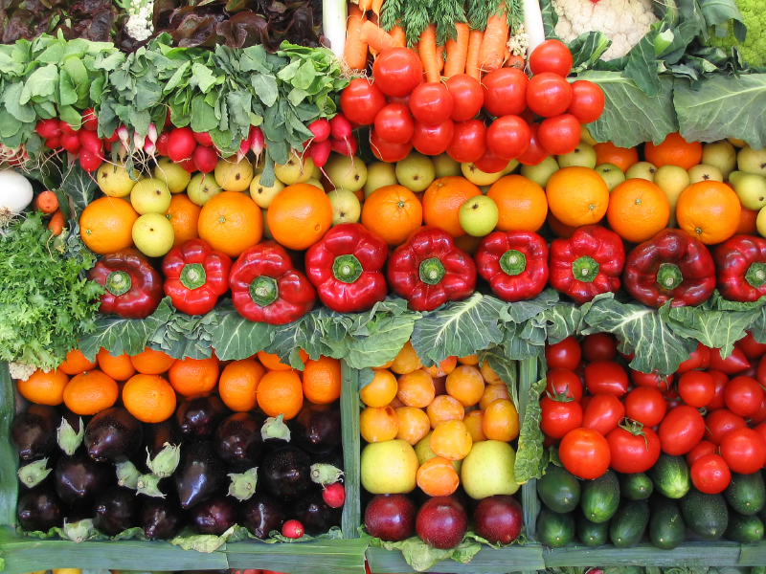
[Food Group 200]
Ans: Vegetables, diary, and meat/beans

Slide 7
[Food Group 300]
True or false—“The stripes of the Food Pyramid represent different food groups. The thicker the stripe of a certain food group, the more important it is for our body.”
Explain your
answer choice

Slide 8
6.Ans: True or false—“The stripes of the Food Pyramid represent different food groups. The thicker the stripe of a certain food group, the more important it is for our body.”
[Food Group 300]
False – If a stripe for a certain food group is thicker, it does not mean it’s more important, because all food groups are important! If a food group has a thicker stripe, it means we should eat more of it comparing to a food group that has a thinner stripe. For example, we should eat more fruits comparing to oil because the stripe that represents fruit is thicker. (but both fruits and oil are important!)

Slide 9
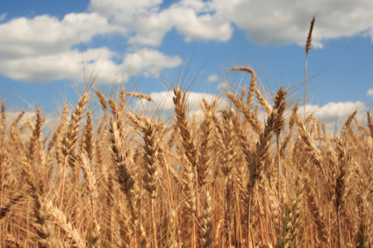
[Food Group 400]
Grain is one of the 6 food groups. What type of grain should you consume more and why?

Slide 10
[Food Group 400]
Whole grain! Because it contains more fiber.

Slide 11
[Nutrients 100]
There are 6 major types of nutrients. Which two nutrients are missing from the list below?
Protein, vitamins, mineral, water, ___?____, ___?_____

Slide 12
[Nutrients 100]
Ans: There are 6 major types of nutrients. Which two nutrients are missing from the list below?
Protein, vitamins, mineral, water, carbohydrate, fat

Slide 13
[Nutrients 200]
Give one example of a food that is rich in fiber, and give one reason why someone should eat food that contains more fiber.

Slide 14
[Nutrients 200]
Ans:
Fruits/vegetables and whole grains are rich in fiber.
Benefits of fiber: prevents constipation, lowers the risk of certain diseases, helps with digestion, makes you feel full faster…

Slide 15
[Nutrients 300]
Fiber belongs to this group:
1.) carbohydrate
2.) fat
3.) protein

Slide 16
[Nutrients 300]
Fiber belongs to this group:
1.) carbohydrate
2.) fat
3.) protein

Slide 17
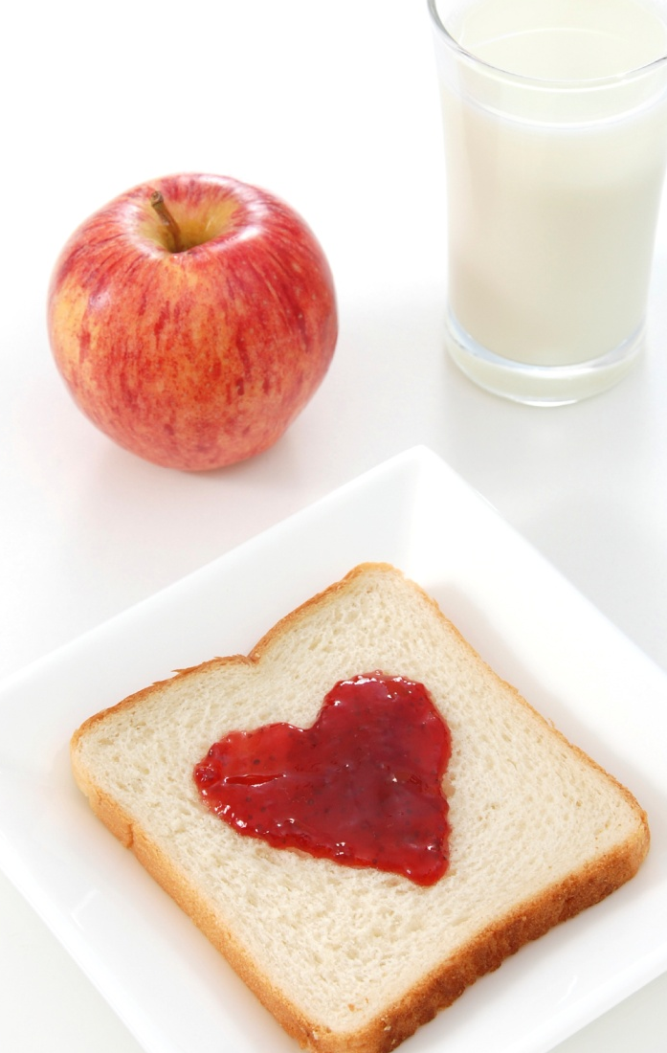
[Nutrients 400]
Name two vitamins or minerals and explain why they are good for your body.

Slide 18
[Nutrients 400]
(multiple answers are accepted; answers are not limited to the following)
Vit A: gives you healthy skin, eyes, and hair
Vit D: bone and teeth development
Vit C: helps maintain hard bones and teeth; prevents infections, colds, fatigue and stress
Calcium: builds bones and teeth
Iron: important for the formation of red blood cells

Slide 19
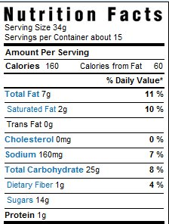
[Food Label 100]
The label says “2g” under “saturated fat.” This means that:
a.) This entire product contains 2 grams of saturated fat.
b.) One serving of this product contains 2 grams of saturated fat.

Slide 20
[Food Label 100]
The label says “2g” under “saturated fat.” This means that:
Ans:
a.) This entire product contains 2 grams of saturated fat.
b.) One serving of this product contains 2 grams of saturated fat.

Slide 21
[Food Label 200]
How can you tell how much “energy” a food product contains?

Slide 22
[Food Label 200]
Ans: You can tell how much “energy” a food product contains by looking at how much calories it has (as shown in the nutrition label).

Slide 23
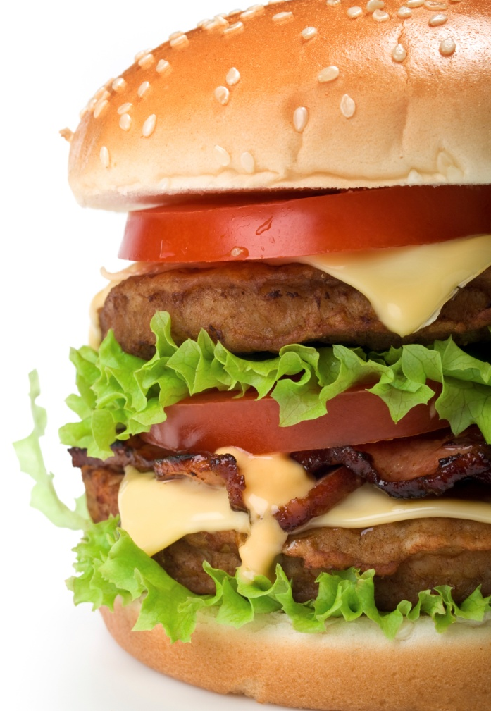
[Food Label 300]
By looking at a food label, how can you determine if a food product contains too much salt?

Slide 24
[Food Label 300]
Ans:
Milligrams of salt ≤ calories
(For example, if a product contains 500 calories, the amount of salt should be less than 500 milligrams.)

Slide 25
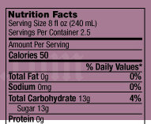
[Food Label 400]
How many calories are in this bottle of drink?

Slide 26
[Food Label 400]
2.5 servings x 50 calories per serving = 125 calories

Slide 27

[Physical Activity 100]
What are two reasons why exercising is good for you?

Slide 28
[Physical Activity 100]
Ans: (multiple answers are accepted; answers are not limited to the following)
1. prevents weight gain (obesity) and other related diseases
2. helps you focus and do better in school
3. exercising is fun
4. makes you a stronger person

Slide 29
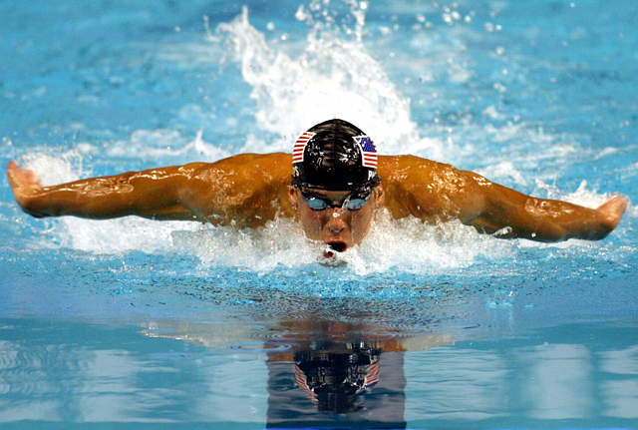
[Physical Activity 200]
How many hours of exercise should you get each day?

Slide 30
[Physical Activity 200]
How many hours of exercise should you get each day?
Ans: ONE hour

Slide 31
[Physical Activity 300]
Running is a type of
a.) strength training exercise.
b.) stretching exercise.
c.) aerobic exercise.

Slide 32
[Physical Activity 300]
Ans: Running is a type of
a.) strength training exercise.
b.) stretching exercise.
c.) aerobic exercise.

Slide 33

[Physical Activity 400]
If you consume more calories than your body needs, the excess calories will be stored as _________.

Slide 34
[Physical Activity 400]
If you consume more calories than your body needs, the excess calories will be stored as fat.

Slide 35
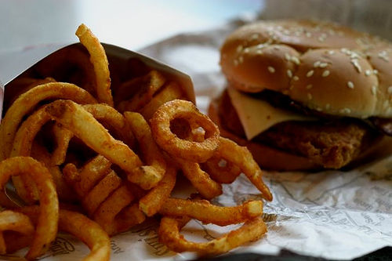
[Scenario 100]
Your friend Christina eats packaged cookies and fast food every day and doesn’t like to eat vegetables and fruits. Name 2 nutrients that she may be getting too much.

Slide 36
[Scenario 100]
Your friend Christina eats packaged cookies and fast food every day and doesn’t like to eat vegetables and fruits. Name 2 nutrients that she may be getting too much.
Ans:
Sugar (carbohydrate), fat, salt (mineral)….

Slide 37
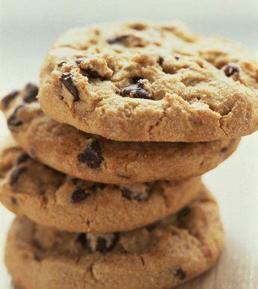
[Scenario 200]
Your friend Christina eats packaged cookies and fast food every day and doesn’t like to eat vegetables and fruits. Name 2 nutrients that she may be lacking.

Slide 38
[Scenario 200]
Your friend Christina eats packaged cookies and fast food every day and doesn’t like to eat vegetables and fruits. Name 2 nutrients that she may be lacking.
Ans: (answers are not limited to the ones below)
Vitamins, minerals, fiber….

Slide 39
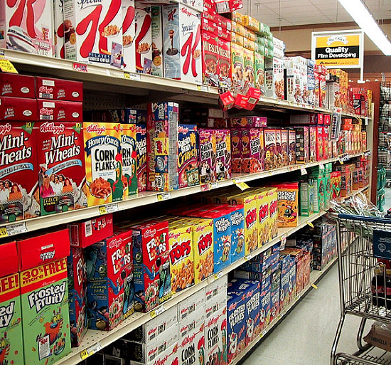
[Scenario 300]
Your friend Stephanie thinks that packaged, processed food is better than whole, fresh food. Is she right? Why or why not?

Slide 40
[Scenario 300]
Your friend Stephanie thinks that packaged food better than whole, fresh food. Is she right? Why or why not?
No, because when foods get processed/packaged, many important nutrients are taken out in the process.

Slide 41
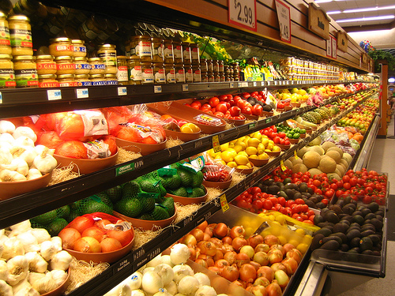
[Scenario 400]
How can you have access to healthy foods without spending a lot of money?
Provide one tip.

Slide 42
[Scenario 400]
(answers are not limited to the following; students only need to provide ONE tip)
1. Buy fruits that are in season, because they are not only more nutritious, but are also cheaper.
2. Check out a few supermarkets or grocery stores to find out which stores usually sell cheaper fruits/vegetables.
3. If you have time, you can grow your own vegetables in a yard or in a pot.

